Slide 1
Introducing Recordkeeping to Farmers Receiving Technical Assistance from International Aid Organizations
By Howard Fenton
University of Wisconsin-Extension
Cooperative Extension
Notes:
Our discussion this morning is based on work I did introducing record keeping to small-scale farmers in Guyana and Honduras as a volunteer in Partners of the Americas’ Farmer to Farmer Program.

Slide 2
Potential Benefits from Recordkeeping
Getting control of the production process.
Showing how labor could be used more productively.
Stepping up food production.
An important input that positively influences the economic results on the farm.
Keeping physical records has a significantly greater influence on farm output than does keeping financial records.
Notes:
There are benefits to be gained from keeping records of farming operations for those ready to make that step. There are two resources to account for, physical and financial. Records of physical resources will tell a farmer how many hours of his labor, and of hired labor, went into a given crop; how much fertilizer, herbicide and pesticide were used and what kinds; what kind of transport was used; who they bought from and sold to.

Slide 3
Notes:
Misters Sigmund McKenzie, Ernest Cummings, and Robert France attended a workshop on record keeping in Georgetown, Guyana. They are shade house farmers growing leafy vegetables for the local restaurants and hotels. They were young, entrepreneurial, and rather well educated by Guyanian standards. Other sessions were held with the Trafalgar Union Community Development Council (a council of village women raising tilapia in a number of fish ponds), Hauraruni Friendly Farmers’ Society (a rather large farming cooperative using drip irrigation technology imported from Israel), and Mr. David January (an individual edoe, or taro, farmer).

Slide 4
Benefits of Record Keeping
Ernest Cummings: “If you want to manage and get ahead then you have to think of little ways to do so with cutting costs and everything. This is something new and I would never have thought of it.”
Notes:
Mr. Cummings manages an 18’ x 24’ shade house in the backyard of his family’s house. He supplies hotels and restaurants with lettuce, celery, and tomatoes. With the vegetables he grows he has been able to increase his annual income about $400. This, in a county where the 2012 median average income was $3,410. Mr. Cummings attributes his new knowledge and skills to the shade house staff and other producers.
The Farmer to Farmer Program: A Case Study, by UW-Extension, Cooperative Extension, Program Development & Evaluation (Kerry Zaleski, Jennifer Kushner, Samuel Pratsch, Claire Clugston, and Larry Jones), May 20, 2013.

Slide 5
Benefits of Record Keeping
Sigmund McKenzie, Farmer to Farmer Field Officer and shade house producer. Uses a simple record keeping system to improve planning and decision-making.
Notes:
Mr. McKenzie has a business providing seedlings to shade house farmers. He employs a record keeping system using simple ledgers to document expenditures, sales and income on a monthly basis. Mr. McKenzie speaks of the record keeping system as key to his planning and decision making. He uses the information he collects to project future production, weekly sales and incidentals. He says the system also helps with reducing costs by calculating exactly how many seeds he needs to buy to cover a bag of the planting medium. Overall, it helps him understand the growth of the business. Using information from his records he has been able to chart his progress, moving from an income of $5 to $250 USD per month over an eight month period.

Slide 6
Capacity Building
The volunteer in relationship with the farmer.
The volunteer in relationship with the host organization staff.
The host organization staff in relationship with the farmer.
The farmer in relationship with other farmers.
Notes:
Sustaining the impact of volunteer visits is critical.
New knowledge doesn’t stick if it isn’t reinforced. Farmers can’t recall the names of the volunteers who visited them. Rather they point to staff members of the host organization and fellow farmers as the source of their new knowledge.
This is where it becomes important to develop the capacity of the host organization staff and creating an environment that encourages a joint learning process. Multiplier effect.

Slide 7
Partners of the Americas, Farmer-to-Farmer Flex Program
My assignment was to demonstrate a simple method of keeping written records of crop production activities and resources used during the crop production cycle. The goal was to help farmers better manage costs and physical resources.
Notes:
My assignment in Honduras was to introduce a simple method of record keeping. I worked with the staff of FUCOHSO (Honduras Foundation for Sustainable Harvest) to conduct 7 workshops with 88 participants; 62 (70%) male and 26 (30%) female.

Slide 8
Participatory Learning
Acquiring new knowledge.
Having a dialogue.
Giving learners some ownership in the learning process.
Practical experience to enhance learning.
Shared learning.
Notes:
The workshops lasted 4 – 5 hours not counting the breaks for lunch. Other than introducing the specifics of the recordkeeping system all the information came from the participants. Their participation was a very critical element of the workshops.

Slide 9
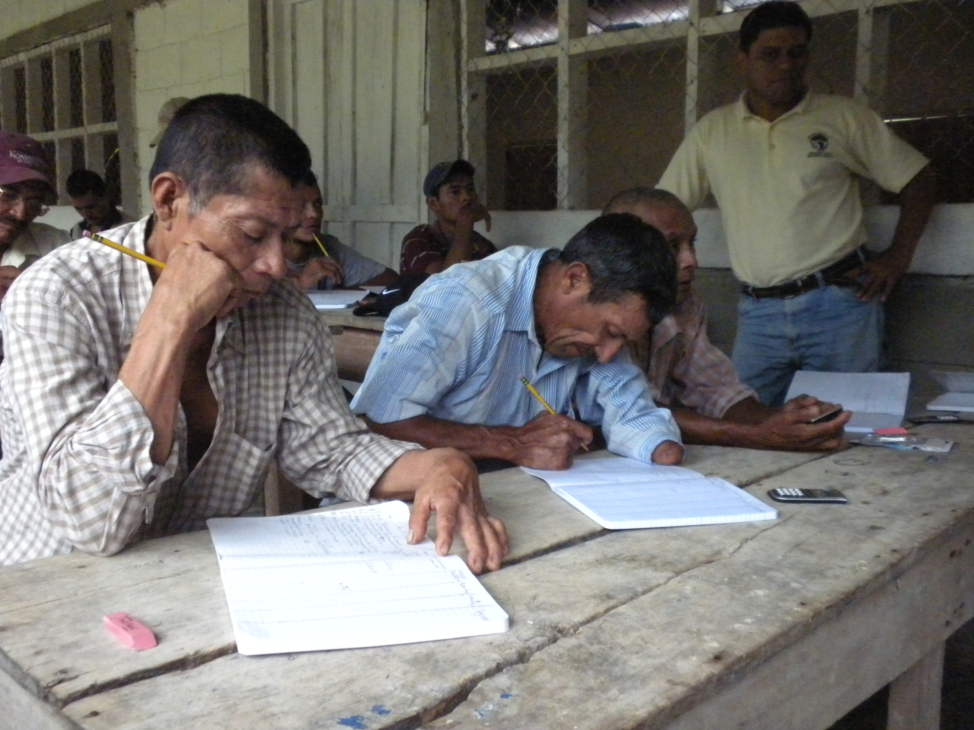

Slide 10
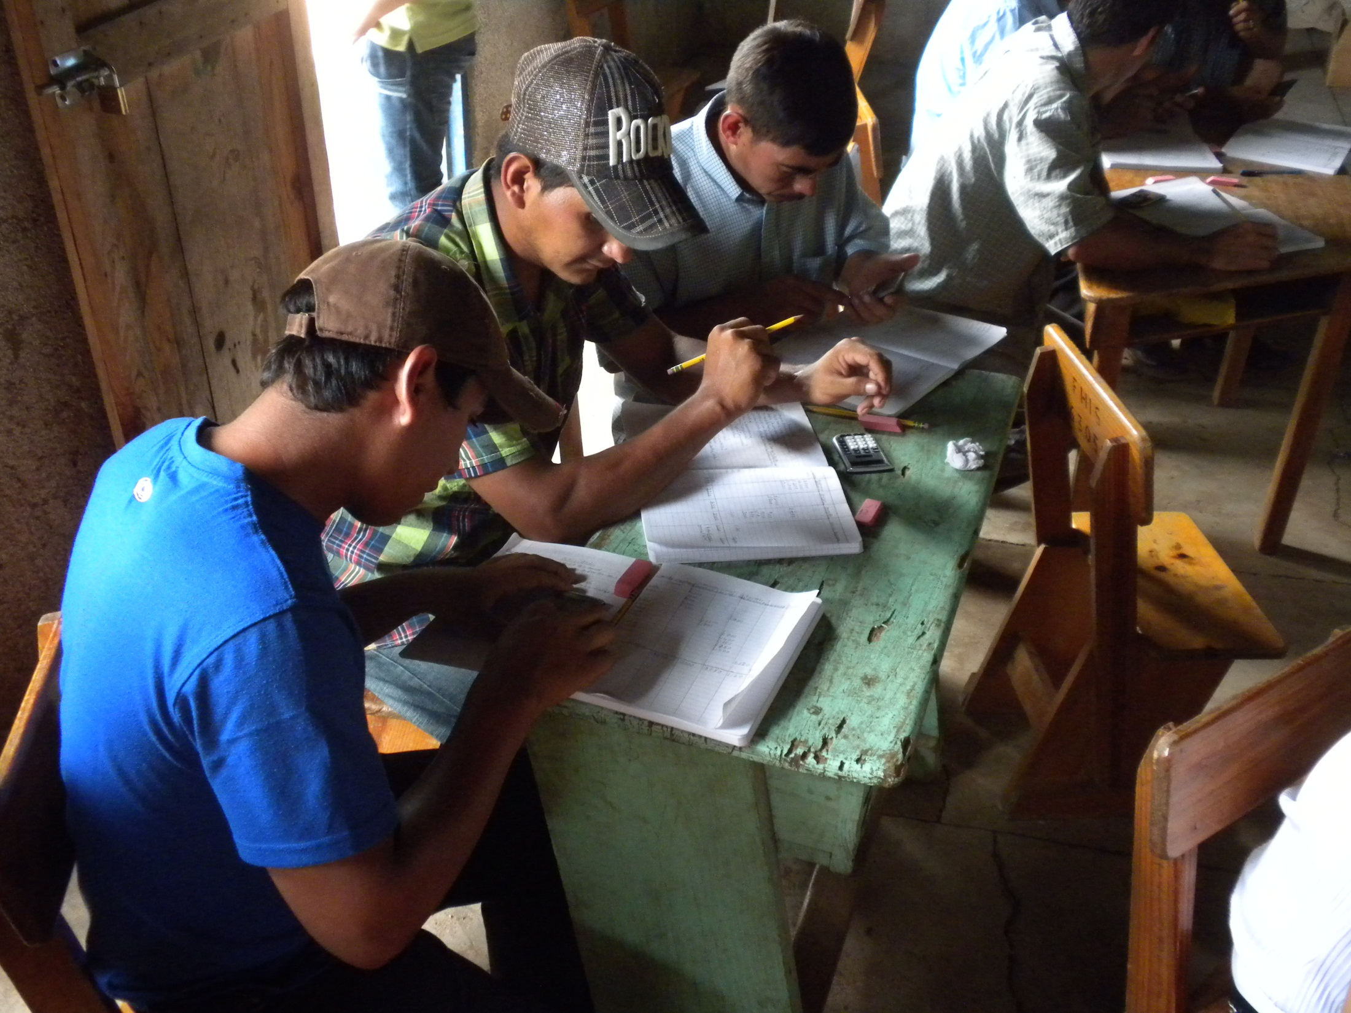
Notes:
These young men were very engaged and seemed to have little difficulty understanding the concepts and instructions.
They worked together and hopefully they are still, to this day, helping each other, prodding and asking questions of each other about this new farm management tool.
And who knows, when they have children in the future who are their age now, they may be using tablets to keep their records. “There’s an app for that.”

Slide 11
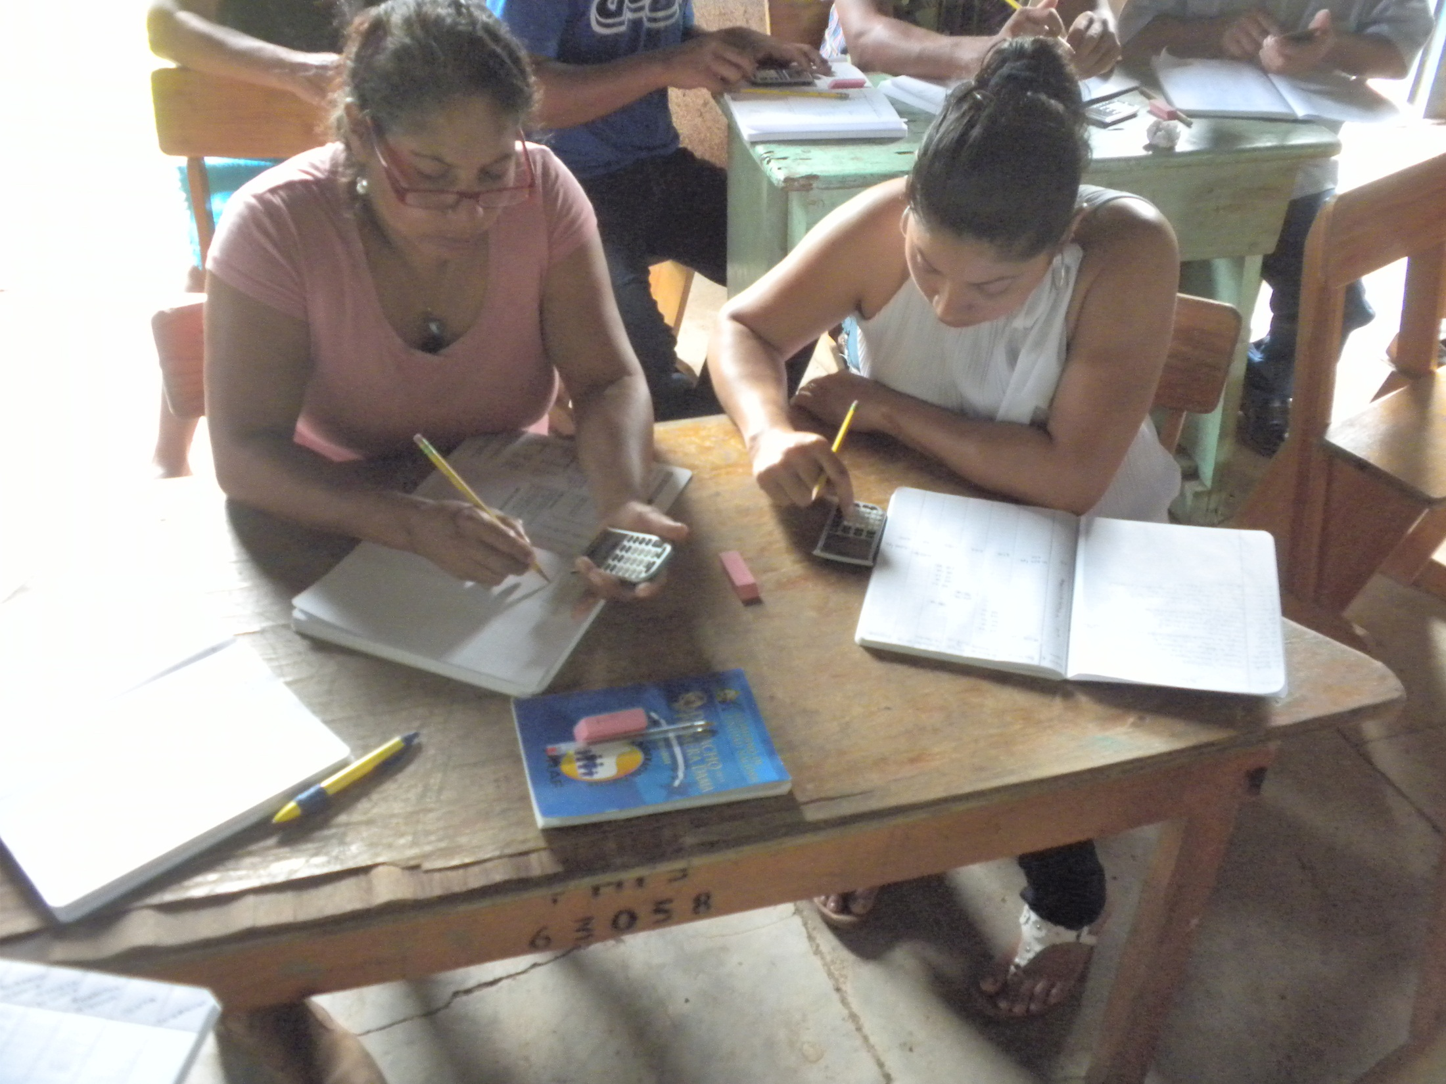
Notes:
Women made up 30% of the participants.

Slide 12
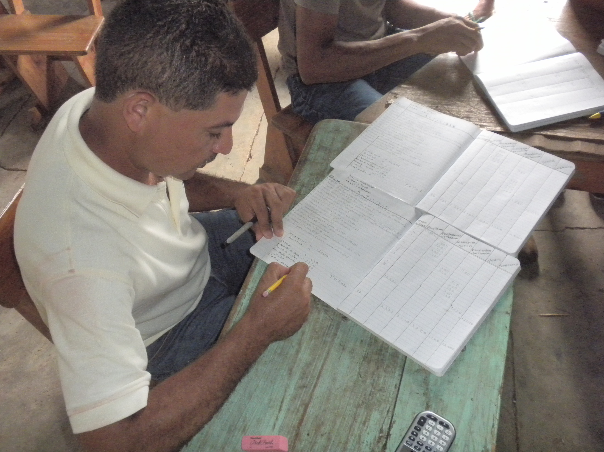
Notes:
Having FUCOHSO field technicians participating was key to capacity building within the orgranization.

Slide 13
A Participatory Approach
Select a crop for demonstration purposes.
Identify all the activities in the production cycle.
Group activities based on the similarity of their purpose.
Set up the record keeping book.
Record financial, physical units and personal labor for each activity throughout the production cycle.
Total results and prepare a simple income statement to determine net income and return for each hour of personal labor.
Notes:
Crops were corn (3), beans (2), cardamom (1), and coffee (1).

Slide 14
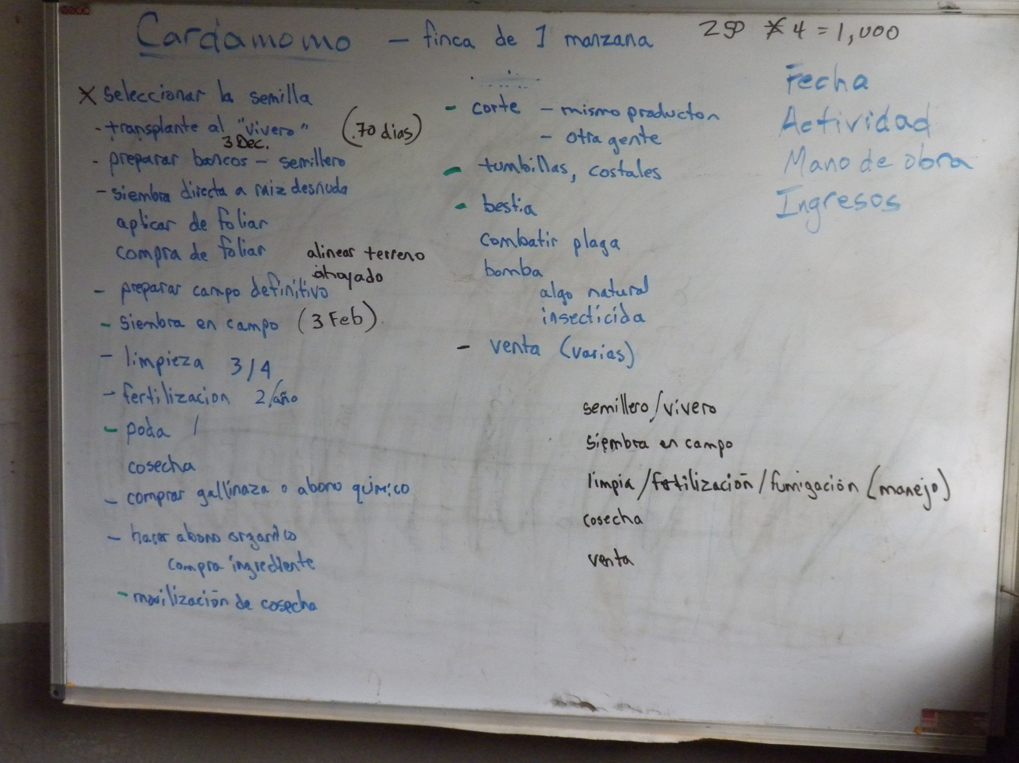
Notes:
1 manzana = 1.7 acres; standardize activities and input requirements.
Semillero/vivero – getting seeds started in the nursery
Siembra en campo – transplanting to the field.
Limpia/fertilizacion/fumigacion (manejo) – managing the crop as it grows.
Cosecha – harversting.
Venta – selling.

Slide 15
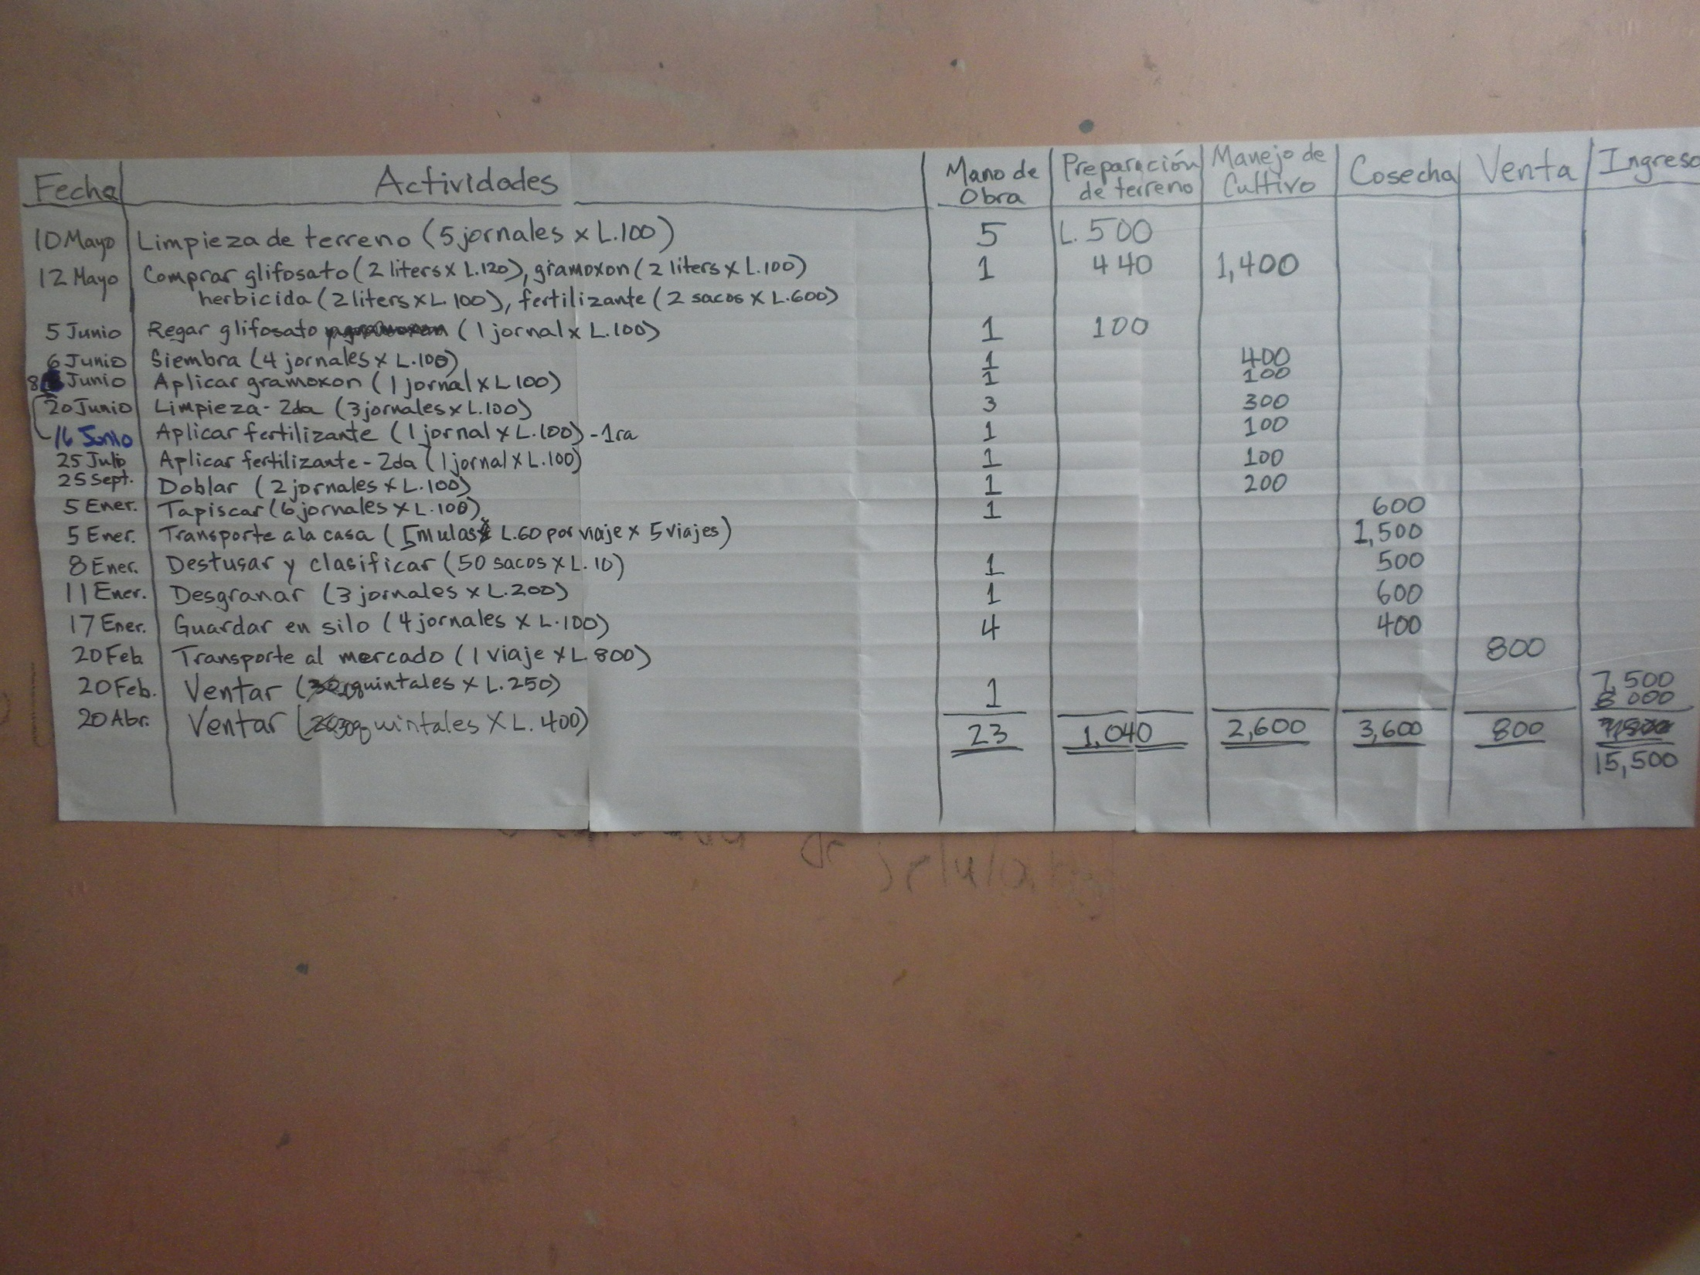

Slide 16
Results
In our example a single manzana (about 1.7 acres) of land yielded a return of $7,460 Lempira. For an estimated 23 days of personal labor that works out to about $L324 per day (or a little more than $US8 day at an exchange rate of $L19 = $US1).

Slide 17
A Teachable Moment
Roy Lara, a FUCOHSO agronomist and Program Leader, uses the results from our demonstration to emphasize some financial advantages of substituting expensive store-bought fertilizers with organic, homegrown fertilizers.
Notes:
The use of bocachi reduces the need of other external inputs and increases the efficient use of locally available resources in a sustainable way.
Bocachi fertilizer is produced by the fermentation process of organic material in good humidity and temperature conditions. Recipe includes: vegetable matter, animal dung, ash, bran, sugar water, and yeast.

Slide 18
Next Steps
Are volunteer visits a good investment? Are they effective?
How do we know?
Surveys:
Pre-workshop.
Post-workshop. Focus on adapting rather than adopting?
Months/years later.

Slide 19
Questions
Do you have any questions?
My questions for you:
What major core idea did you get from this session?
What were you hoping to hear but didn’t?

Slide 20
Introducing Recordkeeping to Farmers Receiving Technical Assistance from International Aid Organizations
Howard Fenton
UW-Extension, Cooperative Extension
432 N. Lake Street
Madison, WI 53706
608-263-0758 (w) or 608-228-2202 (c)
howard.fenton@ces.uwex.edu

